Slide 1

Describe Azure management and governance
AZ-900: Microsoft Azure Fundamentals

Slide 2

Exam objectives
TOPICS:
Describe cost management in Azure
Describe features and tools in Azure for governance and compliance

Slide 3

Topic 1:
Describe cost management in Azure
Describe factors that can affect costs in Azure
Compare the Pricing calculator and the Total Cost of Ownership (TCO) calculator
Describe the Azure Cost Management and Billing tool
Describe the purpose of tags

Slide 4
Factors affecting cost in Azure
Azure shifts development costs from capital expense (CapEx) of building out and maintaining infrastructure and facilities to an operational expense (OpEx) of renting infrastructure as you need it, whether it’s compute, storage, networking, and so on.
The OpEx can be impacted by many factors:
Resource type
Consumption
Maintenance
Geography
Subscription type
Azure Marketplace
Source

Slide 5
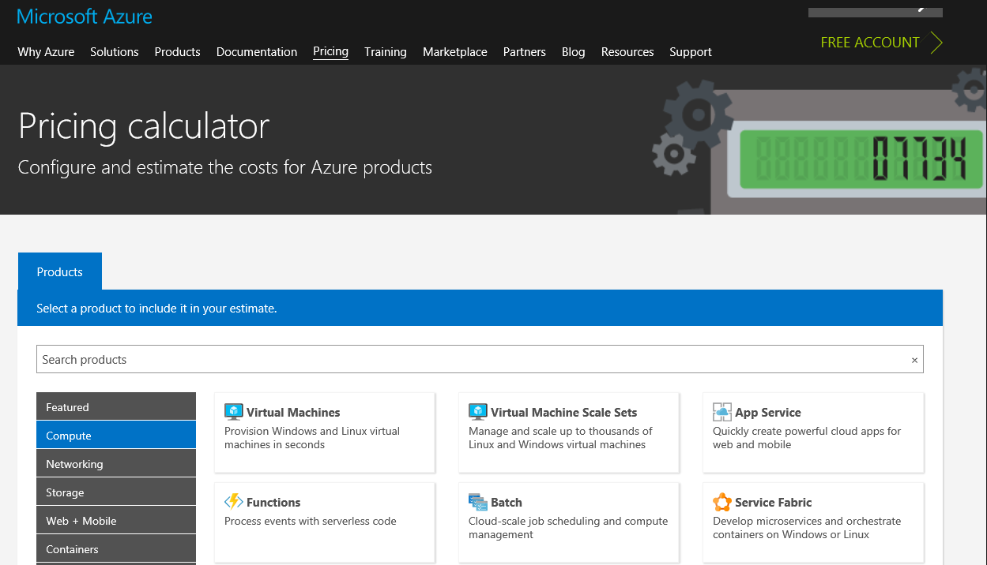
Pricing Calculator
It is designed to give you an estimated cost for provisioning resources in Azure.
The pricing calculator’s focus is on the cost of provisioned resources in Azure.
The pricing calculator is for information purposes only. The prices are only an estimate. Nothing is provisioned when you add resources to the pricing calculator, and you won’t be charged for any services you select.
Image source: https://subscription.packtpub.com/book/cloud-and-networking/9781789614503/8/ch08lvl1sec65/the-azure-pricing-calculator
Source

Slide 6
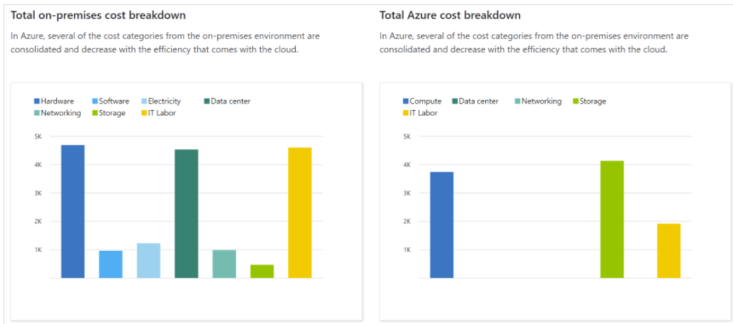
What’s the TCO Calculator
The TCO (total cost of ownership) calculator helps you estimate the cost savings of operating your solution on Azure over time, instead of in your on-premises datacenter.
Source

Slide 7
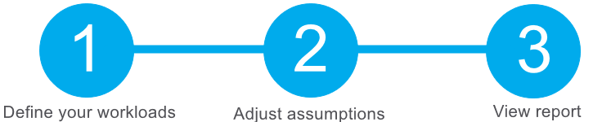
How does the TCO Calculator work?
Servers
Database
Storage
Networking
Electricity price per kilowatt hour (KWh).
Hourly pay rate for IT administration.
Network maintenance cost
Choose a time frame between one and five years, it will generate a downloadable report
Source

Slide 8
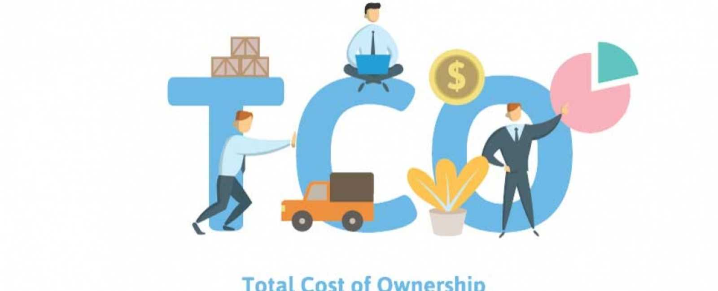
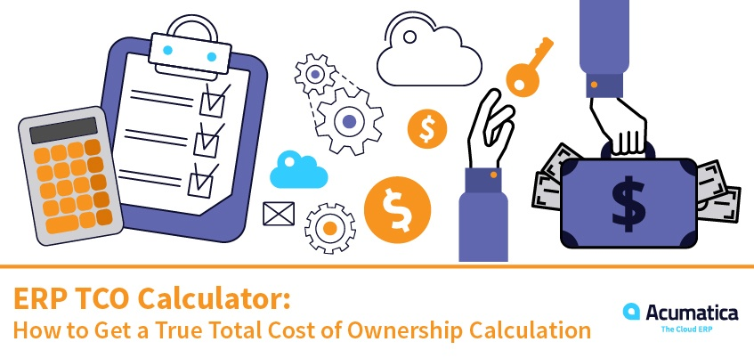
Activity
Compare sample workload costs by using the TCO Calculator
TCO Calculator
Lab instructions
Duration: 20 min
Source

Slide 9
Purchase Azure services
Azure offers both free and paid subscription options to fit your needs and requirements.
Free trial: provides you with 12 months of popular free services, a credit to explore any Azure service for 30 days, and more than 25 services that are always free. Your Azure services are disabled when the trial ends or when your credit expires for paid products, unless you upgrade to a paid subscription
Pay-as-you-go: enables you to pay for what you use by attaching a credit or debit card to your account.
Member offers: Your existing membership to certain Microsoft products and services might provide you with credits for your Azure account and reduced rates on Azure services.
Source

Slide 10
What factors affect cost?
Resource type + customization: For example, with a storage account you specify a type (such as block blob storage or table storage), a performance tier (standard or premium), and an access tier (hot, cool, or archive). These selections present different costs.
Usage meters: Overall CPU time, Time spent with a public IP address, Incoming (ingress) and outgoing (egress) network traffic, Disk size and amount of disk read and disk write operations
Resource usage: Deallocating a VM when you don't plan on using it for some time is just one way to minimize costs.
Azure subscription types: Azure free trial subscription provides access to a number of Azure products that are free for 12 months. It also includes credit to spend within your first 30 days of sign-up.
Azure Marketplace: You can also purchase Azure-based solutions and services from third-party vendors through Azure Marketplace. Billing structures are set by the vendor.
Location: Different regions can have different associated prices. Because geographic regions can impact where your network traffic flows

Slide 11
Zones for billing of network traffic
Some inbound data transfers (data going into Azure datacenters) are free.
For outbound data transfers (data leaving Azure datacenters), data transfer pricing is based on zones.
A zone is a geographical grouping of Azure regions for billing purposes
Zone 1: North America, Europe, Middle East, and Africa
Zone 2: Asia Pacific (including Japan)
Zone 3: South America
Zone 4: Australia and New Zealand
Zone 5: India

Slide 12
Manage and minimize total cost on Azure
Understand estimated costs before you deploy:Calculate your projected costs by using the Pricing calculator and the Total Cost of Ownership (TCO) Calculator. Only add the products, services, and resources that you need for your solution.
Use Azure Advisor to monitor your usage: Azure Advisor identifies unused or underutilized resources and recommends unused resources that you can remove.
Use spending limits to restrict your spending: when you spend all the credit included with your Azure free account, Azure resources that you deployed are removed from production and your Azure virtual machines (VMs) are stopped and deallocated. The data in your storage accounts is available as read-only.
Use Azure Reservations to prepay: Azure Reservations can save you up to 72 percent as compared to pay-as-you-go prices. To receive a discount, you reserve services and resources by paying in advance

Slide 13
Manage and minimize total cost on Azure (cont’d)
Choose low-cost locations and regions:The cost of Azure products, services, and resources can vary across locations and regions. If possible, you should use them in those locations and regions where they cost less.
Research available cost-saving offers:Keep up to date with the latest Azure customer and subscription offers, and switch to offers that provide the greatest cost-saving benefit
Use Azure Cost Management + Billing to control spending: a free service that helps you understand your Azure bill, manage your account and subscriptions, monitor and control Azure spending, and optimize resource use.
Apply tags to identify cost owners: You can apply tags to groups of Azure resources to organize billing data.
Resize underutilized virtual machines: resize or shut down VMs that are underutilized or idle.
Delete unused resources: Regularly review your environment, you aren't using a resource, you should shut it down.
Migrate from IaaS to PaaS services: PaaS provides ready-made development and deployment environments that are managed for you.

Slide 14
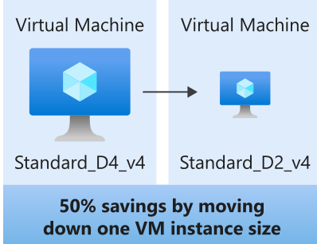
Manage and minimize total cost on Azure (cont’d)
Save on licensing costs:the cost depends on which OS you are using (Windows or Linux). If you've purchased licenses for Windows Server or SQL Server, you might be able to repurpose those licenses on VMs on Azure.

Slide 15
Using resource tags
One way to organize related resources is to place them in their own subscriptions. You can also use resource groups to manage related resources
Resource tags are another way to organize resources. Tags provide extra information, or metadata, about your resources.
This metadata is useful for:
Resource management:to locate resources that are associated with specific workloads
Cost management and optimization: allows you to report on costs, track budgets
Operations management: to group resources according to how critical their availability is to your business
Security: to classify data by its security level, such as public or confidential
Governance and regulatory compliance: for governance or regulatory compliance requirements
Workload optimization and automation: to visualize all of the resources

Slide 16
Topic 2:
Describe features and tools in Azure for governance and compliance
Describe the purpose of Azure Blueprints
Describe the purpose of Azure Policy
Describe the purpose of resource locks
Describe the purpose of the Service Trust Portal

Slide 17
Using resource locks
A resource lock prevents resources from being accidentally deleted or changed.
Even with Azure RBAC policies in place, there's still a risk that people with the right level of access could delete critical cloud resources.
A resource lock is a warning system that reminds you that a resource should not be deleted or changed.
Available levels of locking
CanNotDelete means authorized people can still read and modify a resource, but they can't delete the resource without first removing the lock.
ReadOnly means authorized people can read a resource, but they can't delete or change the resource.

Slide 18
Control and audit your resources by using Azure Policy
Azure policy is a service in Azure that enables you to create, assign, and manage policies that control or audit your resources.
These policies enforce different rules and effects over your resource configurations so that those configurations stay compliant with corporate standards.
Azure Policy in action
Implementing a policy in Azure Policy involves these three steps:
Create a policy definition.
Assign the definition to resources.
Review the evaluation results.

Slide 19
What are service-level agreements (SLAs)?
A service-level agreement (SLA) is a formal agreement between a service company and the customer. It defines the performance standards that Microsoft commits to for you, the customer
When you build applications on Azure, the availability of the services that you use affect your application's performance.
Downtime refers to the time duration that the service is unavailable.
The difference between 99.9 percent and 99.99 percent might seem minor, but it's important to understand what these numbers mean in terms of total downtime.
A service credit is the percentage of the fees you paid that are credited back to you according to the claim approval process.
Services like Azure Advisor are always free. because it's free, it doesn't have a financially backed SLA.

Slide 20
What happens when the composite SLA doesn't meet your needs?
Choose customization options that fit your required SLA: (disks, Tiers, etc)
Build availability requirements into your design: avoid having any single points of failure.deploy one or more extra instances of the same virtual machine across the different availability zones in the same Azure region.
Include redundancy to increase availability: duplicate components across several regions, known as redundancy.

Slide 21
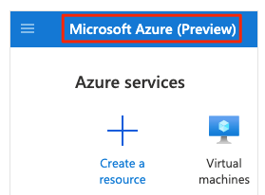
Azure Service Lifecycle
The service lifecycle defines how every Azure service is released for public use.
Every Azure service starts in the development phase. Where the Azure team collects and defines its requirements, and begins to build the service.
Next, the service is released to the public preview phase. During this phase, the public can access and experiment with it so that it can provide feedback.
After a new Azure service is validated and tested, it's released to all customers as a production-ready service. This is known as general availability (GA).
How can I access preview features for the Azure portal?
Enter Preview in the search box:

Slide 22
References:
https://docs.microsoft.com/en-us/learn/modules/choose-azure-services-sla-lifecycle/5-access-preview-services
https://docs.microsoft.com/en-us/learn/modules/choose-azure-services-sla-lifecycle/

